Slide 1
NSI Architecture Document Status and Work to be done: A view from the chairs
Inder Monga
inder@es.net
ESNet

Slide 2
NSI Architecture Specification
Four high-level sections
Context and Motivation
Terminology and Concepts
Architecture
Deployment Use Cases

Slide 3
Context and Motivation
Context and motivation 3
2.1 Background 3
2.2 Introducing the Service Plane 4
2.2.1 OGF Working Groups and documents 4
2.2.2 Other Standards Groups 4
Needs work on Service Plane and Standards groups details

Slide 4
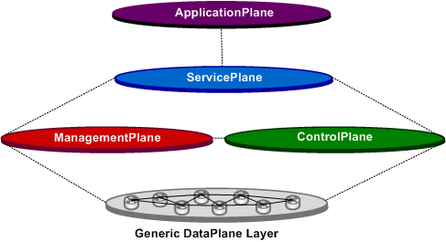
Service Plane
The ServicePlane refers to the set of systems and processes that are geared towards providing services to users and maintaining state on those services. The Service plane will generally rely on the functions of the ControlPlane and/or ManagementPlane to effect actual changes on the DataPlane. In addition, the ServicePlane will typically maintain databases on current and future service instantiations and coordinate associated workflow processes.
Notes:
DataPlane
The DataPlane is the set of network elements which receives, sends, and switches the network data. For this architecture definition we identify the dataplane options in terms of “technology regions”. A “technology region” is a set of network elements which are grouped together and utilize the same dataplane "technology type". The technology types are defined using the standard Generalized Multi-Protocol Label Switching (GMPLS) [] nomenclature of Packet Switching Capable (PSC) layer, Layer-2 Switching Capable (L2SC) layer, Time Division Multiplexing (TDM) layer, Lambda Switching Capable (LSC) layer, and Fiber-Switch Capable (FSC). Additionally, we associate these technology types with the more common terminology of Layer 0, Layer 1, Layer 2, Layer 3, etc. Details on the DataPlane technology types, descriptions and features are provided in the Section 8 (DataPlane).
ControlPlane
The ControlPlane plane is responsible for routing, path computation, and signaling functions associated with control of the DataPlane. This generally includes maintaining topology information and configuring network elements in terms of data ingress, egress, and switching operations. The ControlPlane is one of two CapabilityPlanes which directly interacts with the DataPlane.
ManagementPlane
The ManagementPlane refers to the set of systems and processes that are utilized to monitor, manage, and troubleshoot the network. This includes functions to support user services as well as network maintenance, upgrades, and reconfigurations. This plane is responsible for collecting data and monitoring of the network. In addition, this CapabilityPlane may also include capabilities to configure the network elements with the support of the control plane or via independent actions. The ManagementPlane is one of two CapabilityPlanes which directly interacts with the DataPlane.
AAPlane
This plane is the Authentication and Authorization plane. This plane is responsible for the mechanisms which allow the other planes to identify and authenticate users and receive associated policy information.
ServicePlane
The ServicePlane refers to the set of systems and processes that are geared towards providing services to users and maintaining state on those services. The Service plane will generally rely on the functions of the ControlPlane and/or ManagementPlane to effect actual changes on the DataPlane. In addition, the ServicePlane will typically maintain databases on current and future service instantiations and coordinate associated workflow processes.
ApplicationPlane
The ApplicationPlane provides higher level functions which will generally be tailored for domain specific purposes. It is envisioned that the ApplicationPlane is the area where domain specific experts will be creative and develop capabilities which are specific and unique to their application requirements. The ApplicationPlane will rely on the capabilities offered by one or more ServicePlanes to accomplish its objectives. In this context, the boundary between the ApplicationPlane and ServicePlane is the network demarcation where a detailed and specific network service interfaces will be defined.
Generalized Multi-Protocol Label Switching (GMPLS) Architecture, RFC 3945, October 2004

Slide 5
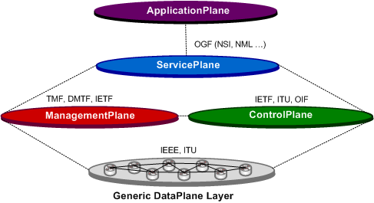
Standards Bodies and where do they fit!

Slide 6
Discussed Yesterday
Introduction and Overview 5
3.1 Service Plane Concepts 5
3.1.1 Transport Resource 5
3.1.2 Network Service Agent 6
3.1.3 Network Resource 6
3.1.4 Requestor Agent 6
3.1.5 Network Service Interface (NSI) 6
3.2 Infrastructure terminology and description 7
3.3 Transport plane overview and naming description 11
3.4 Use NML model and naming where possible
Need to nail down the terminology ASAP based on working group at OGF 27
NSI create the terminology and take it to NML

Slide 7
NSI operations 21
5.1 Basic operations. 21
5.1.1 Operations of reservation service 21
5.1.2 Operations of on-demand service 22
5.2 Reservation parameters 22
5.3 Support of preemption 24
5.4 Support of policy 24
5.5 Resources vs connections 24
Needs to be significantly modified. It should have “Services” offered, impact of that service on NSI operations, and block diagram/other dependencies in the network.

Slide 8
6 Network Service capabilities used from other standards 25
6.1 security and trust 25
6.1.1 transport layer security 25
6.1.2 service layer security 25
6.1.3 attribute authentication and authorization 25
6.2 resource scheduling 25
6.3 charging, authorizing, allocating 25
6.4 policy capabilities 25
6.5 path computation 25
6.6 monitoring 25
6.7 accounting 25
Security Considerations section should be a dedicated section
Dependent services like Path Computation, if not in scope, should be discussed in the previous section

Slide 9
8 Fault handling 27
8.1 Protection 27
8.1.1 Common Redundancy Strategies 27
8.1.2 Technology dependence 32
8.2 32
8.3 Inter-domain (End-to-End) Protection 32
8.4 Connection Restoration 33
The contents of this section needs to move to appendix or integrated with operational issues. The failure implications of the agents themselves need to be discussed in this section.

Slide 10
9 Examples and use cases [appendix?] 34
9.1 GMPLS intradomain with NS agents 34
9.2 Single layer networks 34
9.3 Multi-layer technology networks 34
9.4 Multi-layer technology with multiplexing 34
9.5 Recursive NS agents 34
These need to be in the appendix or more implementation models.

